Slide 1

Group: 10 COMMERCIAL HOUSE MARKETING ANALYSIS BY
Akhil Kumar
Pavan Chowdary
ChandraSekhar Reddy
Madhu Yadav
Sravani

Slide 2
Introduction
Determines the house prices based on statistics.
Prices vary depending on several factors like location, area, age, number of rooms, etc.
Due to urbanization and industrialization, the cost of houses has significantly increased.
The growth of the country's economy is significantly influenced by real estate, which plays a critical role in economic development.
Rising home prices are indicative of a strong economy, while declining home prices are indicative of a weak economy.

Slide 3
Abstract:
This data collection contains enough observations to allow for data partitioning, which may be necessary to answer a variety of research issues.
Commercial House marketing is a statistical measure of house pricing that takes into account a variety of factors such as price, bedrooms, bathrooms, sqft living, sqft lot, floors, water front, view, condition, year built, year renovated, street, city and country. All of these factors have a role in deciding the price of a home when it is sold or bought.
The price is the dependent or target variable, while all other elements are independent variables. The dataset contains the history values for the target variable. IBM SPSS was used for the analysis.

Slide 4
Roles:
Determine the relationship between the variables.(Pavan Kumar)
Using the supplied independent variables, create a model for forecasting the price of properties.(Madhu Yadav)
To determine the importance of the variables in predicting property prices.(Akhil)
Use the independent variables to calculate the actual price variation
(Chandrasekhar )
Evaluate how well the variables predict property values. ( Sravani )

Slide 5
Problem Statements
To find the relationship between the variables.
To develop a model for predicting the price of the homes with the available independent variables.
To find the significance of the variables in predicting the price of the homes.
To find the exact variation of the prices based on the independent variables.
To find how well the variables define the price of homes.

Slide 6
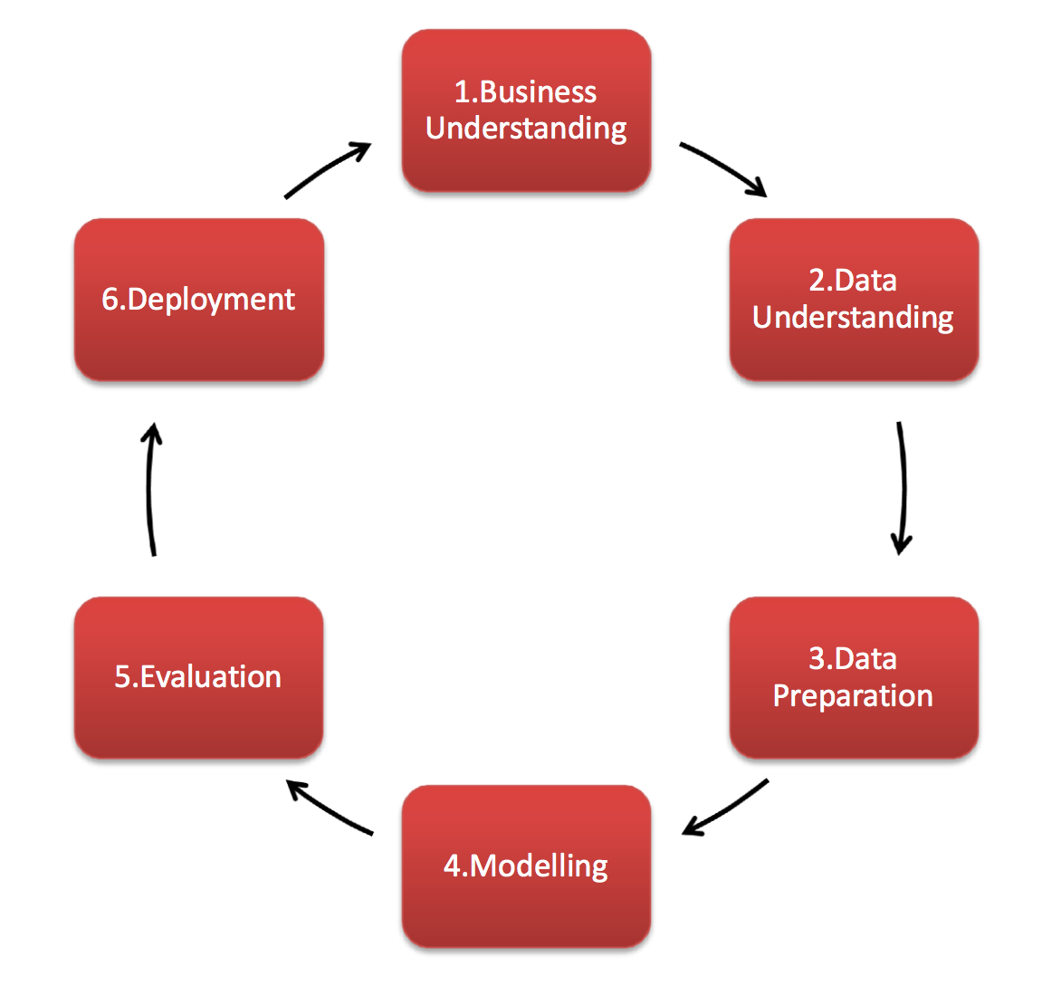
Data Analysis and business understanding
The whole project is based on the SPSS platform. This includes 6 phases.
This method is used for planning, analyzing, organizing, and implementing the project.
Primary goal- predict the prices of the homes
Based on the obtained results, one can calibrate the business strategies in order to meet the certain predefined price levels

Slide 7
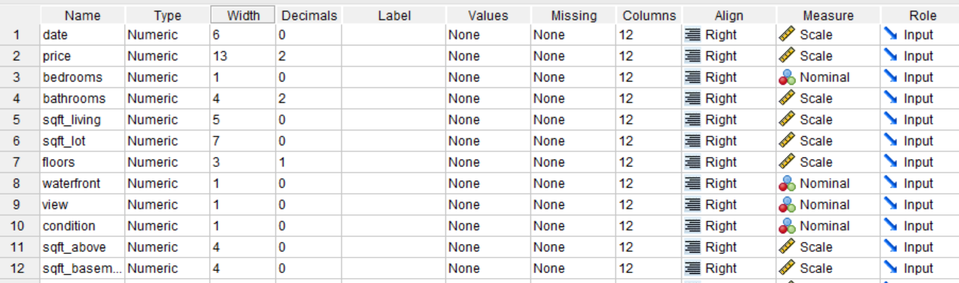
Data Understanding and Preparation
The dataset does not require any cleaning.
When we upload the file, it automatically takes the measure of variables beds and baths as nominal, but the values of these attributes are discrete integer values.

Slide 8
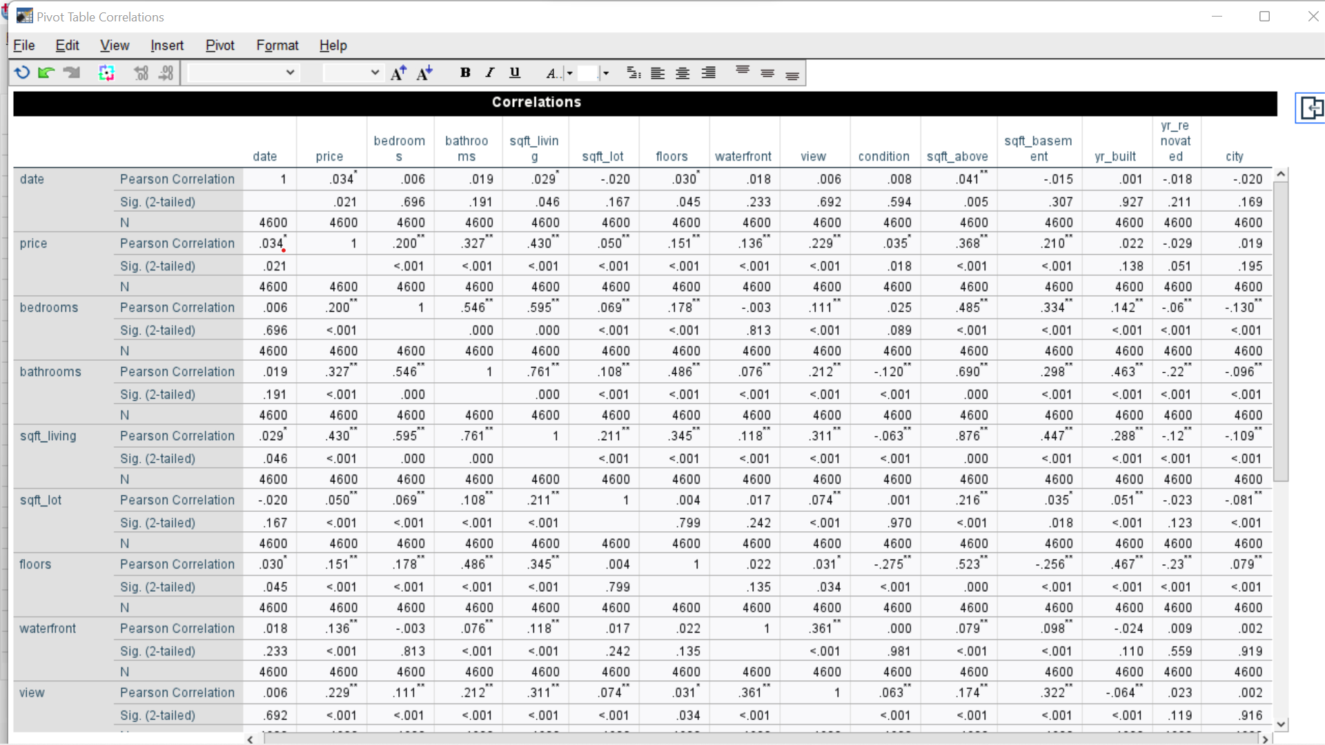
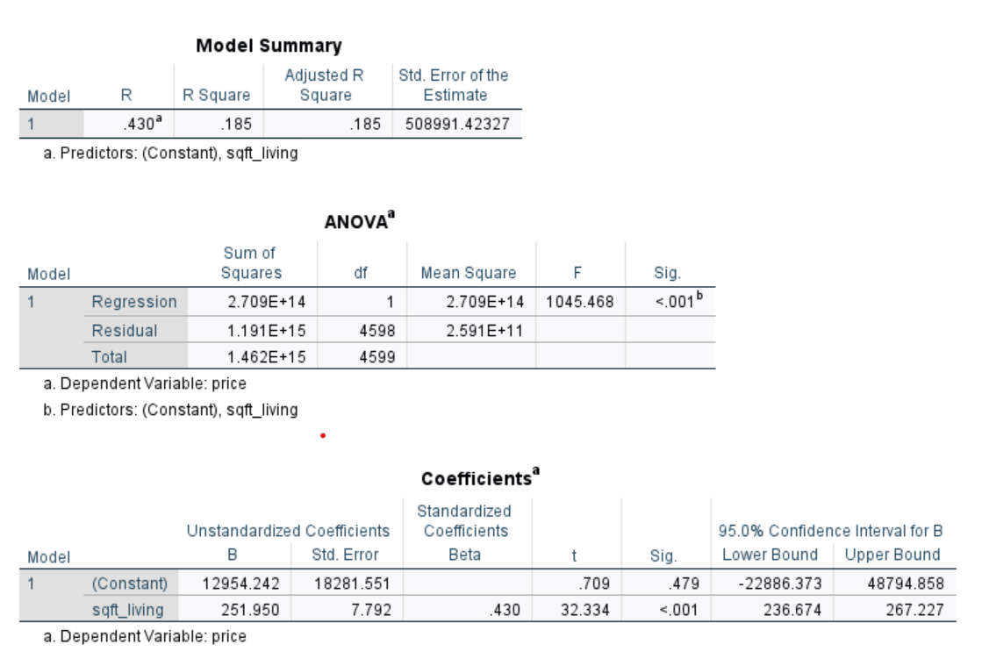
Modeling Techniques: Linear Regressions As price is a targeted variable, correlation of price is drawn against all the other variables. Here, price is more strongly correlated with sqft living with a correlation coefficient of 0.430.So we are performing simple regression with price as dependent variable and sqft living as independent variable.
Price = 12954.242 + 251.950*sqft_living

Slide 9
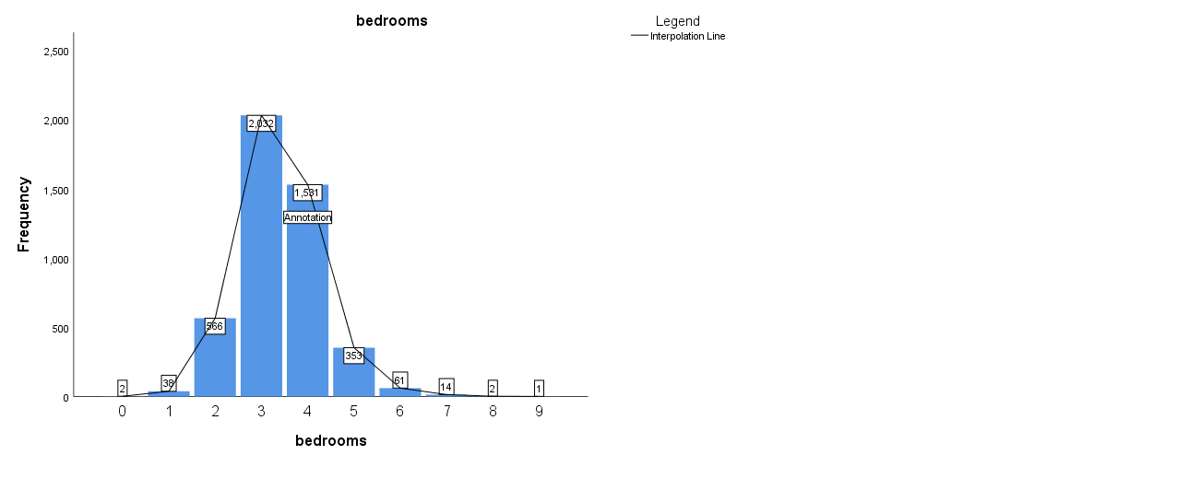
Anova : Tests are performed on Bedrooms, waterfront, view, condition and city are compared with price.
Price vs Bedroom
ANOVA
price
 | Sum of Squares | df | Mean Square | F | Sig.
Between Groups | 62356559332612.650 | 9 | 6928506592512.517 | 22.720 | .000
Within Groups | 1399709561359138.800 | 4590 | 304947616853.843
Total | 1462066120691751.500 | 4599
Based on P value we can conclude that we can reject the null hypothesis.

Slide 10
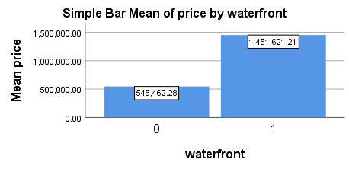
Price VS Waterfront
 | Sum of Squares | df | Mean Square | F | Sig.
Between Groups | 26902699969673.773 | 1 | 26902699969673.773 | 86.191 | .000
Within Groups | 1435163420722076.200 | 4598 | 312127755702.931
Total | 1462066120691750.000 | 4599
Based on P value we can conclude that we can reject the null hypothesis.
Limitations:
Similarly we have computed for other Nominal variables.

Slide 11
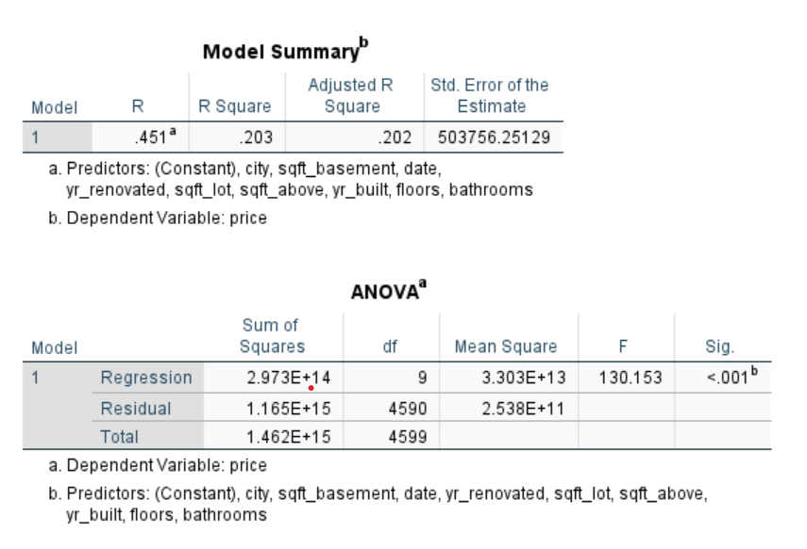
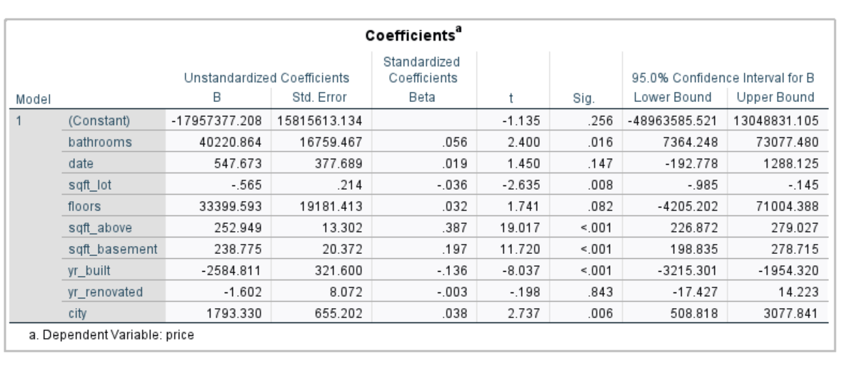
Multiple Linear Regression Multiple linear regression means the prediction of the variable using one or more independent variables. Multiple linear regression is performed to determine the significance of the model and coefficients.
Price = 12954.242 + 251.950*sqft_living

Slide 12
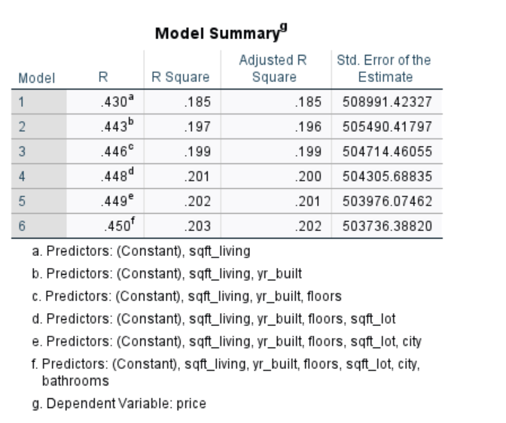
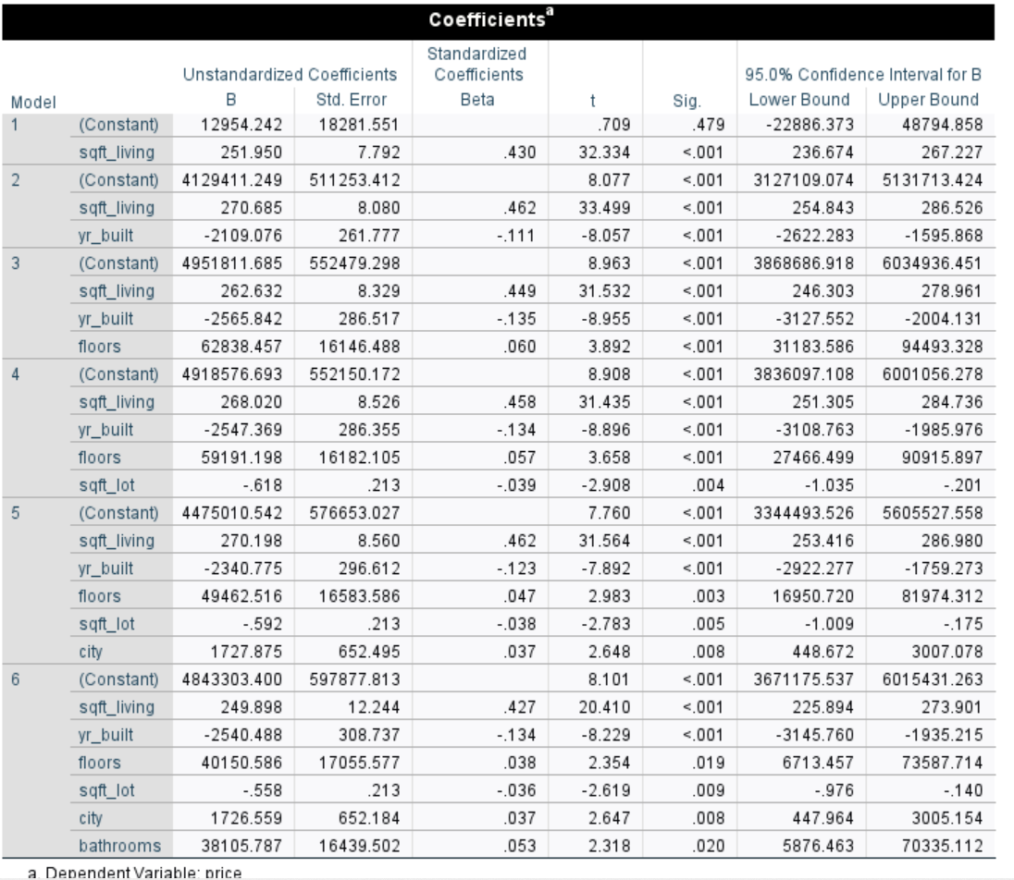
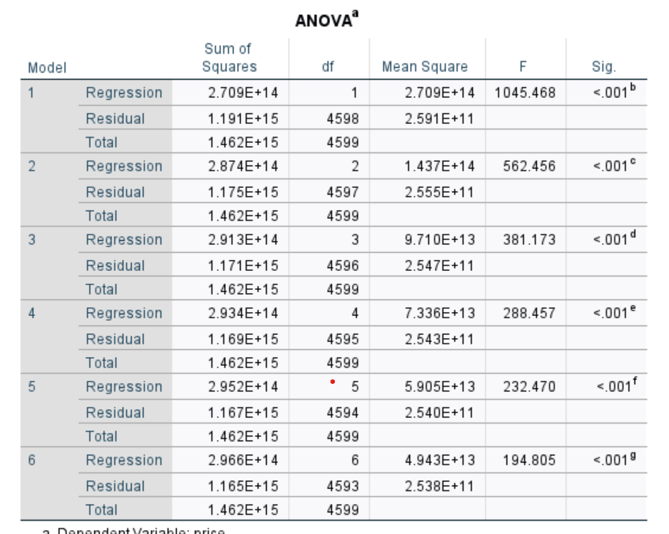
Stepwise Regression (Forward) Stepwise regression is a step-by-step technique. In each step, either a variable is eliminated or added to the variables list based on specified.
Price=4843303.400+249.898*(sqft_living)-2540.488*(yr_built)+40150.586(floors)-0.558(sqft_lot)+1726.559(city) + 38105.787(bathrooms)

Slide 13
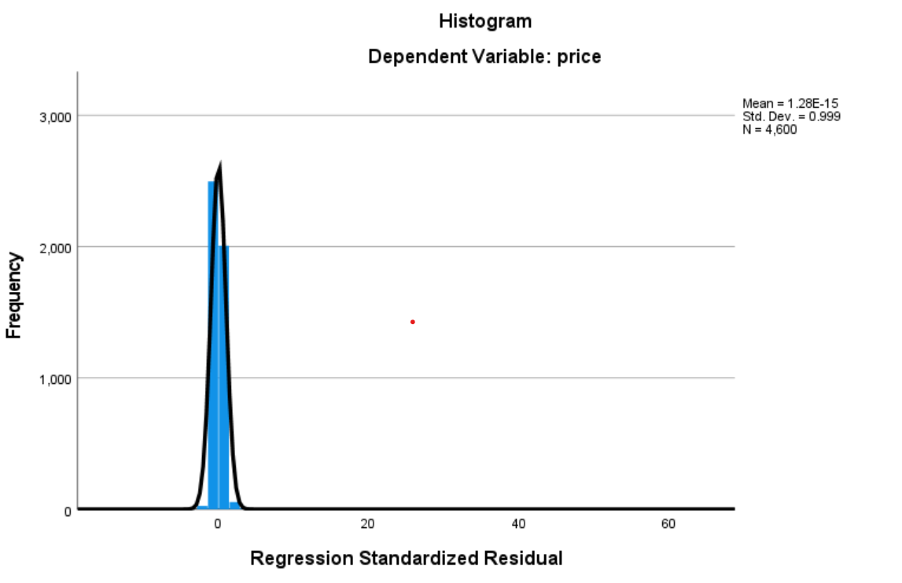
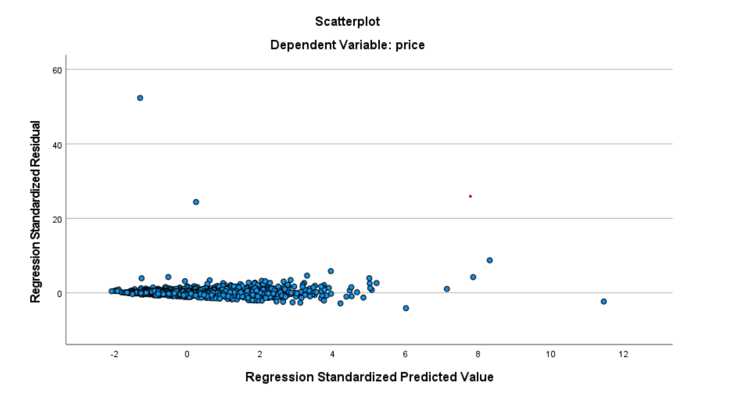
Stepwise Regression(Cont..)

Slide 14

Conclusion
Through correlation, we can explain the relationships between the variables. A step-wise regression model with the dependent variable as price, and all other significant variables as sqft, beds, vacant, and age as independent variables is the best way to accurately predict home prices. These independent variables account for 20 percent of the price volatility. Therefore, the regression model fits 20% of the data..

